Slide 1
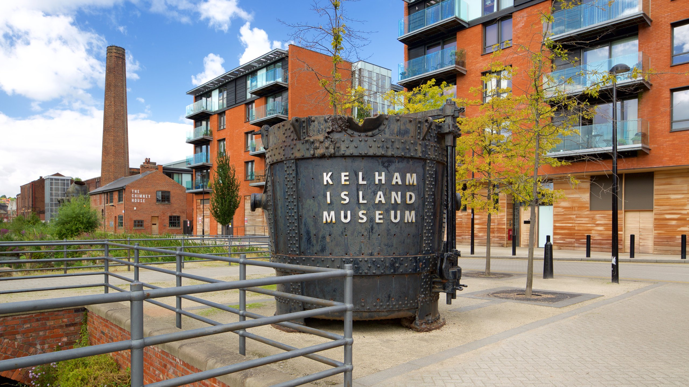
Design an interactive media product
NCFE Unit 2 LO2
Design an interactive media product
Contents
NCFE Unit 2

Slide 2
Introduction
I have been asked to create an interactive product for Kelham island museum to increase interest in the museum and encourage people to visit. It should reflect the style and theme of the museum (industrial) and add an interesting but still education interactive element to the museum.
Contents

Slide 3
Contents
Introduction
Ideas development
ideas development - continued
ideas development – continued again
Chosen audience/end user
Technical aspects
Technical aspects – continued
Fonts
Colour scheme
Design aspects and outline
Design aspects and outline
Conclusion
Conclusion - continued
Contents

Slide 4
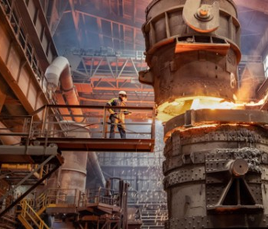
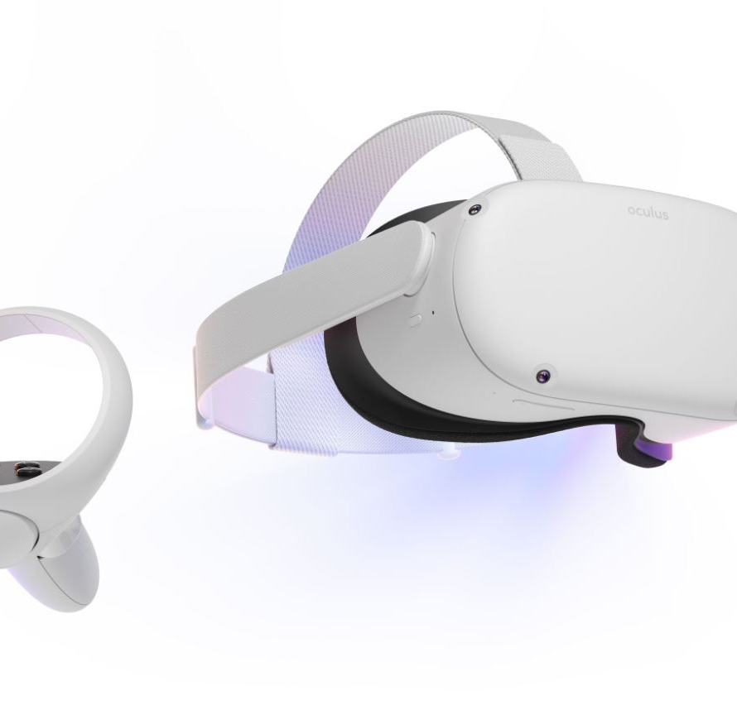
Ideas development
I decided to go with virtual reality for my interactive media project.
It would feature a back-in-time experience of a room in khelam island museum which would immerse the user, it would include audio files and moving 3d models to allow for a full experience letting you experience the conditions people worked in, it would feature optional information pop ups, allowing for the user to be able to experience the area without pop ups getting in the way, but also allowing information and the option to learn.
Contents

Slide 5
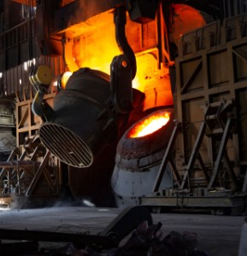
Ideas development – continued
The experience would allow you to walk around a sectioned off area in the museum while wearing the headset.
It would also feature optional information pop ups, allowing for the user to be able to experience the area without pop ups getting in the way, but also allowing information and the option to learn.
Audio would be location based so when you get closer to an object the audio would get louder, there would also be workers using the environment so you can see how the jobs were performed.
Contents

Slide 6
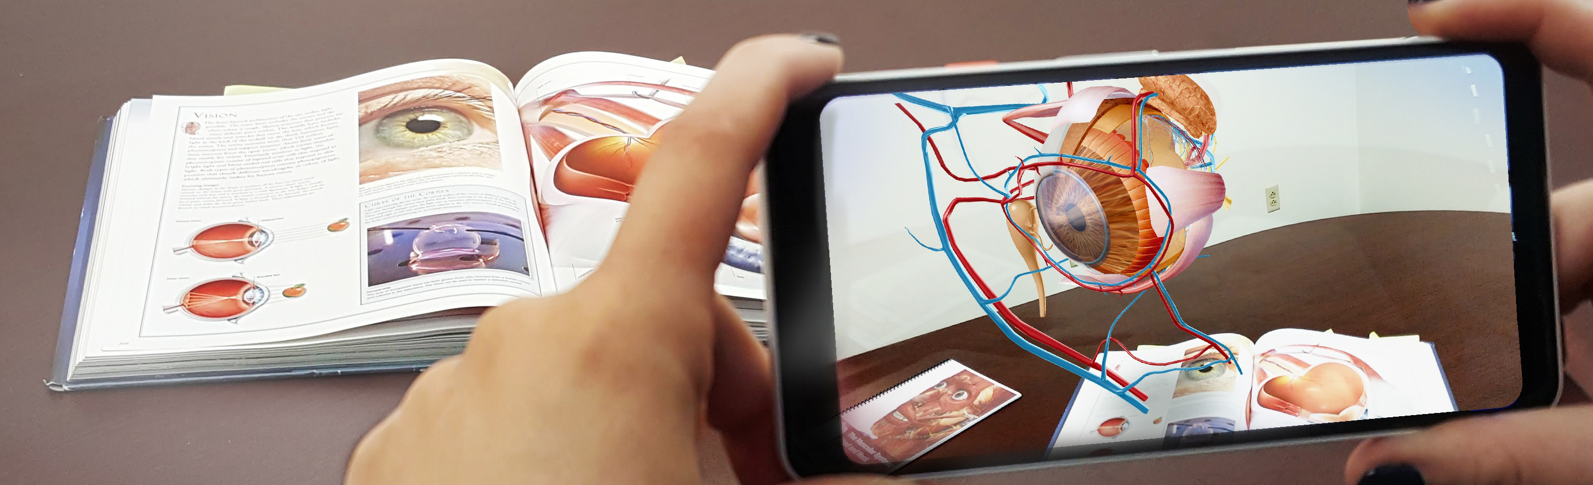
Ideas development - continued
We considered an AR phone app which would have let the user use the camera on their phone to scan a QR code and it would provide more information or an animation of the exhibit in action. It could have also added excitement through it being presented as a kind of treasure hunt which would encourage the user to check out all the exhibits and travel around the entirety of the museum. We decided against this idea as having QR codes everywhere was impractical and some visitors would not want to download an app.
Contents

Slide 7
Chosen audience/end user
Virtual reality greatly appeals to teenagers due to it being engaging and fun to use, because of this it is a great way to get them involved and interested with the museum.
Young children could be less suited to virtual reality because the size of the headset could be too large for some children’s heads.
Adults can find virtual reality appealing, however some adults refuse to embrace it and are wary around VR, the chance of this happening seems to increase with age.
Contents

Slide 8
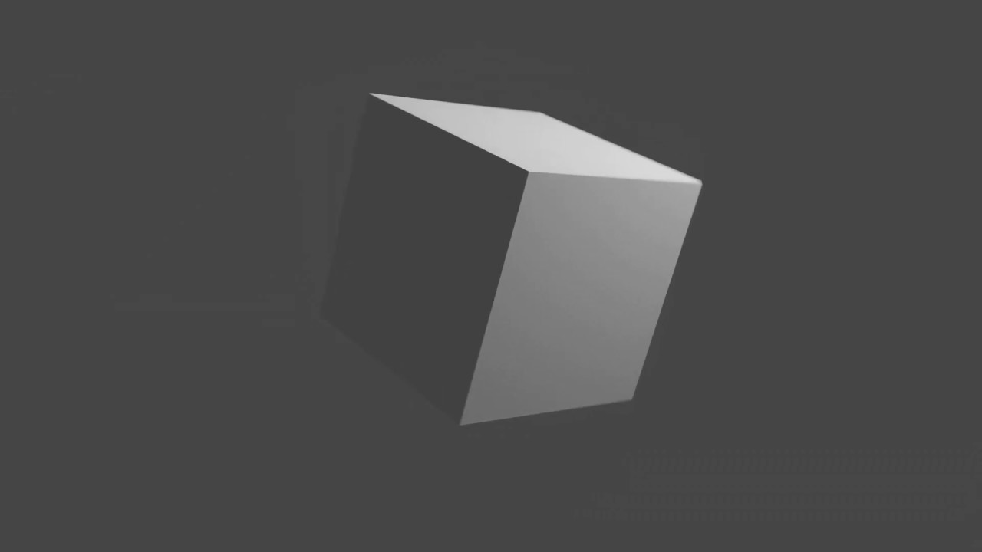
Technical aspects
Virtual reality would require many different file types to create an immersive experience for the user.
We would require 3d models to create the full virtual environment to walk around and explore.
Contents

Slide 9
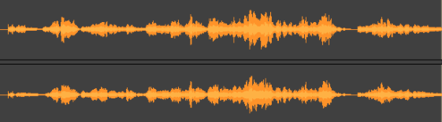
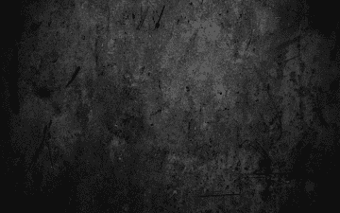
Technical aspects - continued
We would also need
Mp3 – for audio because it has quite a small file size due to it supporting compression
PNG – for images because they have a relatively small file size but also have good quality which is needed as they would be used as textures for 3d models which would improve the experience, we also need to consider how well the image would render, and a smaller image size would increase how fast it would render.
Needs to be high quality but also needs to run fast to stop the user feeling sick but also provide a good experience.
Contents

Slide 10
Fonts
This project wouldn’t require many fonts as most of it is visual rather than written down information, it would still need some fonts for the information pop ups and for that I would use.
Khelam Island (consolas)
Because it is an easy to read sans serif font, is well spaced out, and fits the regular organised style of industry meaning that all ages can easily read and understand it.
Contents

Slide 11
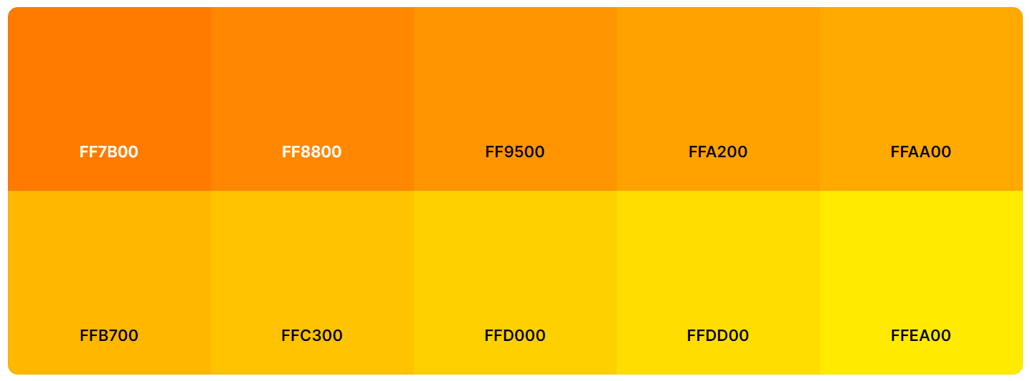
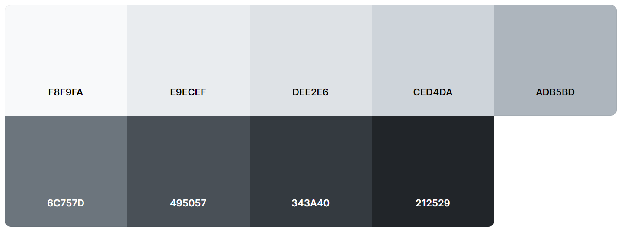
Colour scheme
The colour scheme for the models in my project would be mainly grey metallic colours to fit the old industrial theme.
Reds and oranges would also be included to communicate the heat and show fire/molten metal
Contents

Slide 12

Design aspects/outline
The virtual reality project would have a start up screen which would include sliders for you to be able to adjust volume and how bright/intrusive certain elements such as fire would be, it would also reset you back to the centre and reset all assets in the environment.
This would keep in line with the industrial theme and would use a variety of fonts for different parts of the menu such as Bauhaus 93 for the title and Consolas for the rest of the text.
Contents

Slide 13

Design aspects/outline - continued
We would keep with the industrial colour theme of mainly greys and blacks.
We would need to research a house style and potentially create a logo.
Contents

Slide 14
Conclusion
To create the most enjoyable but also educational experience for the museum virtual reality is the best option.
It would feature two colour schemes, a very industrial grey and black colour scheme and a more fiery colour scheme of oranges, yellows and reds to convey the heat of the environment.
I would use Consolas as my font for the majority of the information because of it’s industrial feel and because it is easy to read. For the title I would use Bauhaus 93 as it adds an even strong feel of industry and stands out.
The project would require a large number of assets which would include MP3 files, PNG’s and blender models (.blend) to create the virtual scene.
Contents

Slide 15
Conclusion - continued
This product would appeal mainly to people in the rough age range of 10-30 but would still work for older and younger audiences.
The actual product would be a virtual reality experience which would allow the user to be “transported back in time”. It would feature informational pop-ups as you look at certain models and would provide a very fun and interesting experience.
Contents

